Slide 1
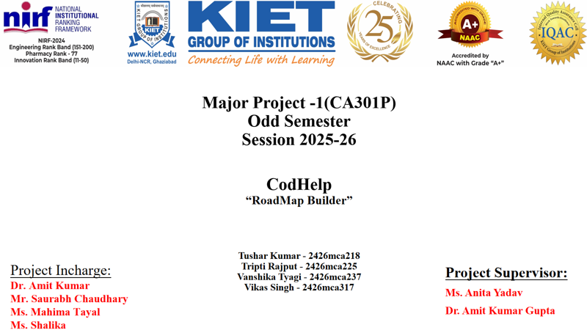
C2D
(CSV TO DASHBOARD)
Vaibhav Singh Kalura(202410116100233)
Vaishnavi Yadav(202410116100234)
Vidushi Agrawal(202410116100243)
Yashvi Chaudhary(202410116100253)

Slide 2
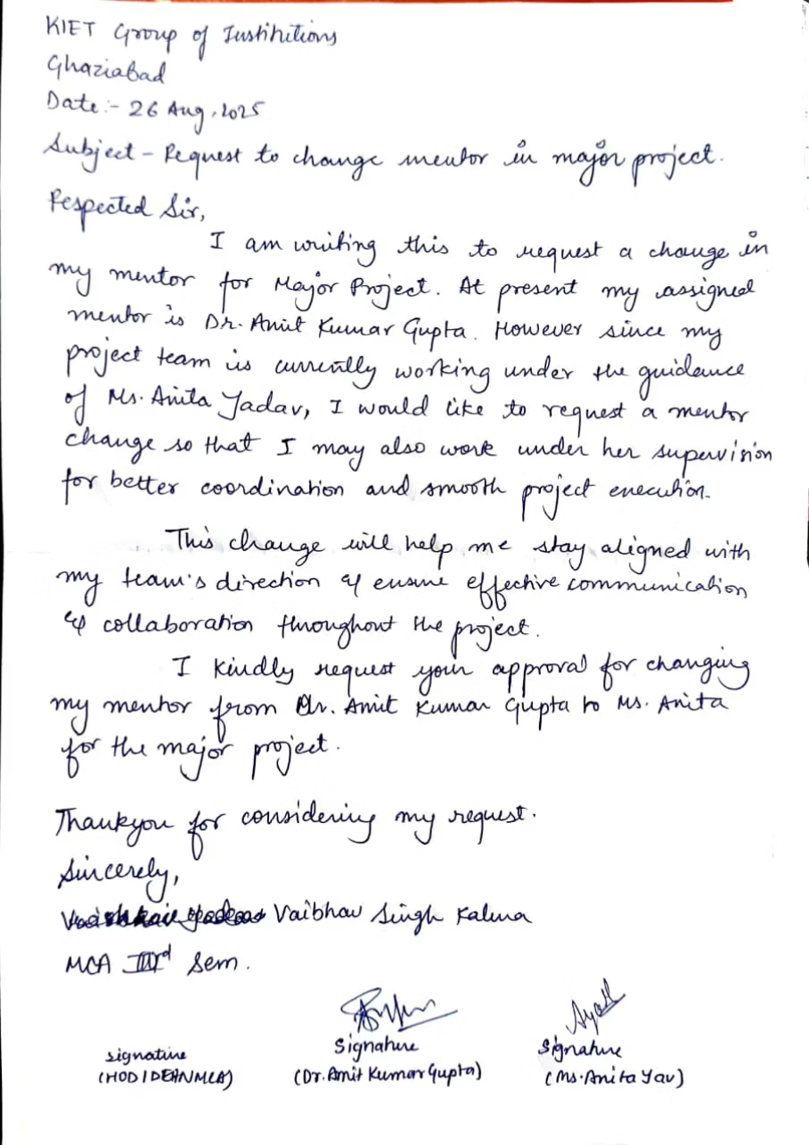
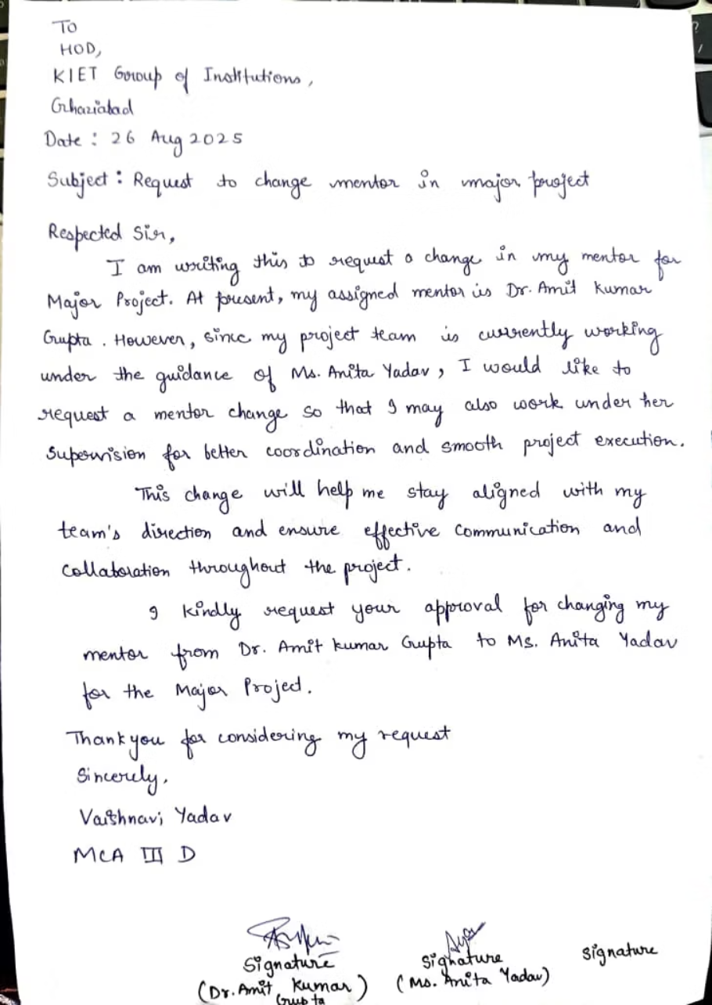
2

Slide 3

🚀C2D
(CSV To Dashboard)
"Turning queries into dashboards with AI Agents"
3

Slide 4

OVERVIEW
Project Introduction
Purpose
Problem Solved
A system that converts user queries into dynamic data dashboards, leveraging multi-agent collaboration.
Automates time-consuming manual dashboarding, democratizing access to visual insights for students, analysts, and businesses.
4

Slide 5








CORE FEATURES
Key Capabilities
Multi-Agent Collaboration
Dynamic Dashboarding
Agents work together to process queries and generate meaningful insights.
Automatically creates dashboards based on user queries.
Data Retrieval & Processing
Interactive Graphs
Fetches relevant datasets and prepares them for visualization.
Uses visualization libraries to present insights effectively.
5

Slide 6
GOALS
Project Objectives
1
Smart Query Handling
2
Automated Data Flow
Enable multi-agent collaboration for intelligent query interpretation.
Automate data retrieval and preprocessing for seamless integration.
3
Interactive Dashboards
4
Insightful Visualizations
Generate dynamic and interactive dashboards using Plotly/Matplotlib.
Provide clear and impactful visualizations for data exploration.
Success measured by query interpretation accuracy, dashboard clarity, and user satisfaction.
6

Slide 7




TECHNOLOGIES
Under the Hood
Autogen
OpenAI
For multi-agent collaboration.
For LLM-powered query interpretation and response generation.
Pandas
Matplotlib / Plotly
For data processing.
For visualization.
7

Slide 8

BOUNDARIES
Project Scope
In Scope
Out of Scope
Query interpretation using LLMs (OpenAI+Autogen)
Building a full-fledged BI tool (e.g., PowerBI/Tableau)
Data fetching & cleaning using Pandas
Handling big data scale (initial prototype for CSV datasets)
Visualization through Matplotlib/Plotly
Dynamic dashboard generation
8

Slide 9

APPROACH
Methodology
Development Approach
Key Tools
Agile methodology with iterative sprints and testing at each stage.
Autogen: Multi-agent orchestration
OpenAI: LLM query understanding
Pandas: Data preprocessing
Matplotlib/Plotly: Visualizations
9

Slide 10

RESULTS
Project Outcomes
Key Deliverables
Future Extensions
Prototype Web App: Dynamic dashboard generator from CSV queries.
Patent/Publication opportunities.
Integration with real-time databases.
Potential for Research Paper: AI-powered dashboarding agents.
Full-scale deployment for broader application.
Real-world Use Cases: Education dashboards, business reports, quick analytics.
10

Slide 11
Thank You!
11

